Slide 1

Intro to object-oriented programming
Chapter 3 – Mental models of objects and the meaning of self

Slide 2
M E N T A L M O D E L S O F O B J E C T S AND THE MEANING OF “SELF”
Some people new to OOP have trouble envisioning what an object is and how the methods of an object work with its instance variables. The specifics are fairly complex, so it can be helpful to develop a mental model of how objects and classes operate.
In this chapter, I’ll present two mental models of OOP. Right up front, I want to be clear that neither of these models is an exact representation of how objects work in Python. Instead, these models are intended to give you a way to think about what an object looks like and what happens when you call a method.

Slide 3
Revisiting the DimmerSwitch Class
In the following examples, we’ll continue with the DimmerSwitch class from Chapter . The DimmerSwitch class already has two instance variables: self.isOn and self.brightness. The only modification we’ll make is to add a self.label instance variable so each object we create can be identified easily in the output when we run our program. These variables are created and assigned initial values in the __init__() method. They are then accessed or modified in the five other methods of the class.
EXAMPLE

Slide 4
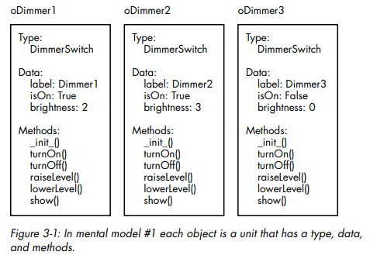
High-Level Mental Model #1
In this first model, you can think of each object as a self-contained unit that contains a data type, a set of the instance variables defined in the class, and a copy of all the methods defined in the class
The data and methods of each object are packaged together. The scope of an instance variable is defined as all the methods in the class, so all methods have access to the instance variables associated with that object.
If this mental model makes the concepts clear, then you’re in good shape. While this is not the way objects are actually implemented, it’s a perfectly reasonable way to think about how an object’s instance variables and methods work together.

Slide 5
A Deeper Mental Model #2
This second model explores objects at a lower level and will explain more about what an object is. Every time you instantiate an object, you get back a value from Python. We typically store the returned value in a variable that refers to the object.
In the EXAMPLE, we create three DimmerSwitch objects. After creating each one, we’ll add code to inspect the result by printing out the type and value of each variable

Slide 6
A DEEPER MENTAL MODEL #2
The first line in each grouping tells us the data type. Instead of a built-in type like integer or float, we see that all three objects are of the programmer-defined DimmerSwitch type. (The __main__ indicates that the DimmerSwitch code was found inside our single Python file, not imported from any other file.)
The second line of each grouping contains a string of characters. Each string represents a location in the memory of the computer. The memory location is where all the data associated with each object can be found. Notice each object is in a different location in memory. If you run this code on your computer, you will most likely get different values, but the actual values do not matter to understanding the concept.
All DimmerSwitch objects report the same type: class DimmerSwitch. The extremely important takeaway is that the objects all refer to the code of the same class, which really only exists in one place. When your program starts running, Python reads through all the class definitions and remembers the locations of all the classes and their methods

Slide 7
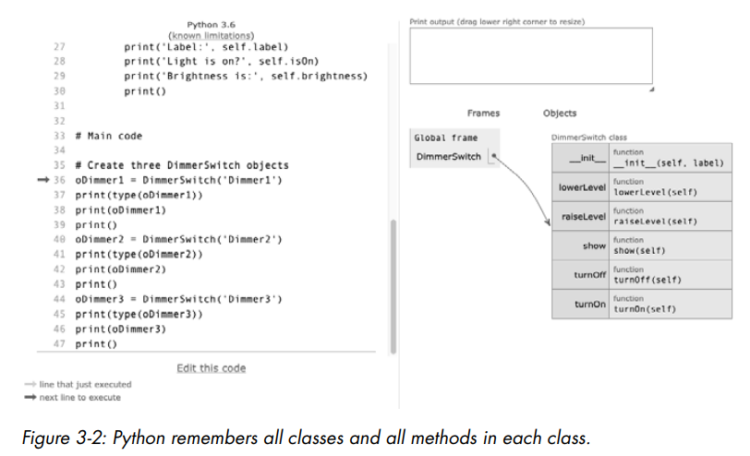
A DEEPER MENTAL MODEL #2
In this screenshot, you can see that Python remembers the location of the DimmerSwitch class and all of its methods. While classes can contain hundreds or even thousands of lines of code, no object actually gets a copy of the class’s code. Having only one copy of the code is very important, as it keeps the size of OOP programs small.
When you instantiate an object, Python allocates enough memory for each object to represent its own set of the instance variables defined in the class. In general, instantiating an object from a class is memory-efficient

Slide 8
What Is the Meaning of “self”?
Suppose you write a class named SomeClass, then create an object from that class, like this:
The object oSomeObject contains a set of all the instance variables defined in the class. Every method of the SomeClass class has a definition that looks like this:
And here is the general form of a call to such a method:
As we know, Python rearranges the arguments in a call to a method, so that the object is passed in as the first argument. That value is received in the first parameter of the method and is put into the variable self

Slide 9
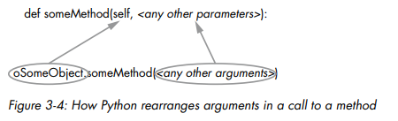
WHAT IS THE MEANING OF “SELF”?
Therefore, whenever a method is called, self will be set to the object in the call. This means that the code of a method can operate on the instance variables of any object instantiated from the class. It does so using the form:
This essentially says to use the object referred to by self and access the instance variable specified by . Since every method uses self as the first parameter, every method in a class uses this same approach.
EXAMPLE

Slide 10
WHAT IS THE MEANING OF “SELF”?
No matter what object we use or which method we call, the value of the object is assigned to the variable self in the called method. You should think of self as meaning the current object—the object that the method was called with. Whenever a method executes, it uses the set of instance variables for the object specified in the call.

